Slide 1
MemReprise
Low-Fi Prototype
Low-Fi Prototype
Casey, Caroline, Kayla, Sophie

Slide 2




Team
Kayla Patterson
Sophie Wu
01
MSCS ‘24
New Jersey
03
BSCS ‘24, MSCS ‘25
Minnesota
Casey Nguyen
Caroline Tran
02
BSCS ‘23, MSCS ‘25
Washington
04
BSCS ‘24, MSCS ‘24
California

Slide 3
Outline
01
04
02
05
03
06
Value Proposition
Interface & Rationale
Problem/Solution
Low-Fi Prototype
Sketching explorations
Tests, Results & Analysis

Slide 4
Where Music and Memories Meet
01
Value Proposition

Slide 5
Problem + Solution
02

Slide 6
The Problem
The Solution
People often have deep, yet hard-to-quantify associations with their favorite music.
These associations go undocumented and unshared.
People often have deep, yet hard-to-quantify associations with their favorite music.
These associations go undocumented and unshared.
Notes:
Associations—memory, emotions

Slide 7
The Problem
The Solution
People often have deep, yet hard-to-quantify associations with their favorite music.
These associations go undocumented and unshared.
People often have deep, yet hard-to-quantify associations with their favorite music.
These associations go undocumented and unshared.
An app that prompts you daily to:
Log the song you’re currently listening to
Notes:
Associations—memory, emotions

Slide 8
The Problem
The Solution
People often have deep, yet hard-to-quantify associations with their favorite music.
These associations go undocumented and unshared.
People often have deep, yet hard-to-quantify associations with their favorite music.
These associations go undocumented and unshared.
An app that prompts you daily to:
Log the song you’re currently listening to
Associate it with a themed question
Notes:
Associations—memory, emotions

Slide 9
The Problem
The Solution
People often have deep, yet hard-to-quantify associations with their favorite music.
These associations go undocumented and unshared.
People often have deep, yet hard-to-quantify associations with their favorite music.
These associations go undocumented and unshared.
An app that prompts you daily to:
Log the song you’re currently listening to
Associate it with a themed question
Tag current mood and activity
Notes:
Associations—memory, emotions

Slide 10
The Problem
The Solution
People often have deep, yet hard-to-quantify associations with their favorite music.
These associations go undocumented and unshared.
People often have deep, yet hard-to-quantify associations with their favorite music.
These associations go undocumented and unshared.
An app that prompts you daily to:
Log the song you’re currently listening to
Associate it with a themed question
Tag current mood and activity
Discover new music by seeing how other users answered and tagged their music
Notes:
Associations—memory, emotions

Slide 11
Sketching Explorations
03

Slide 12
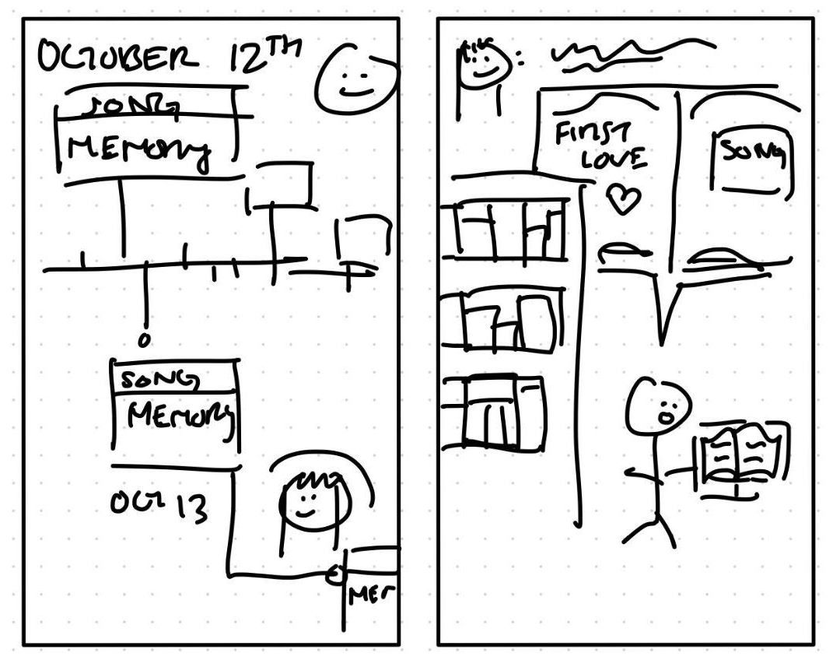
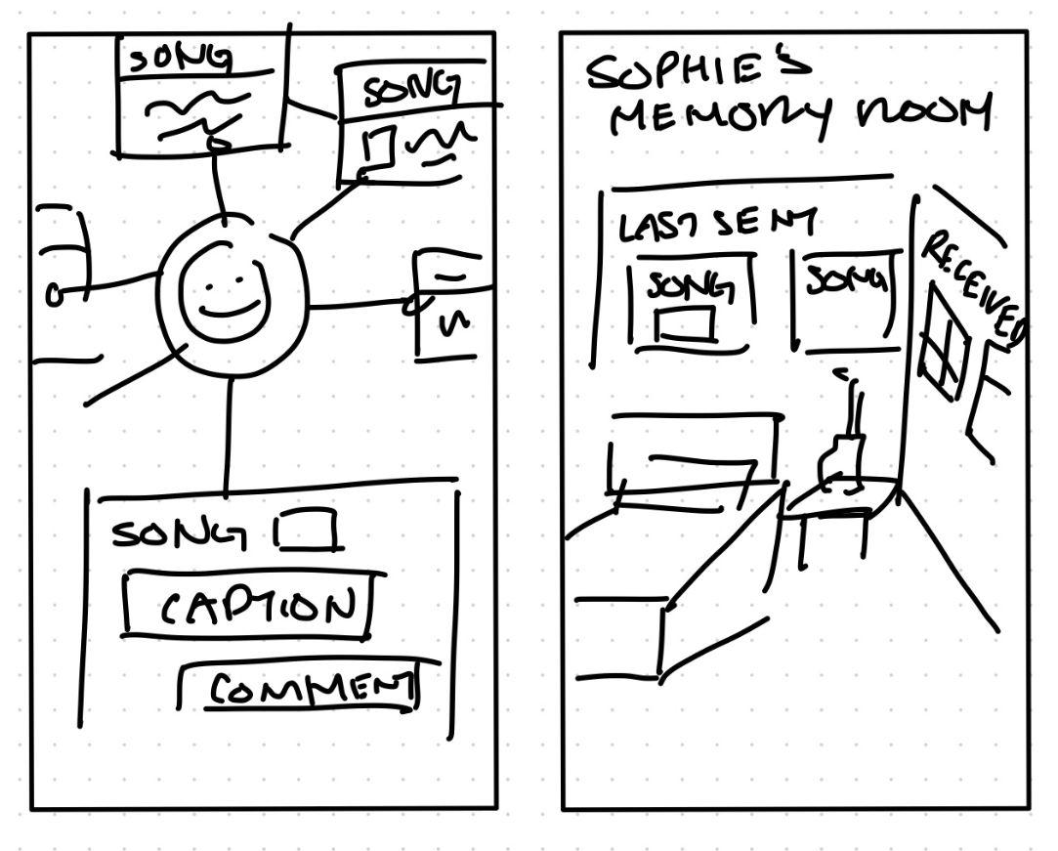
Realizations
Memory Pages
A digital journal-like space where users make “memory posts” with the associated song, relevant images and videos, a written entry, and other connected memories.

Slide 13
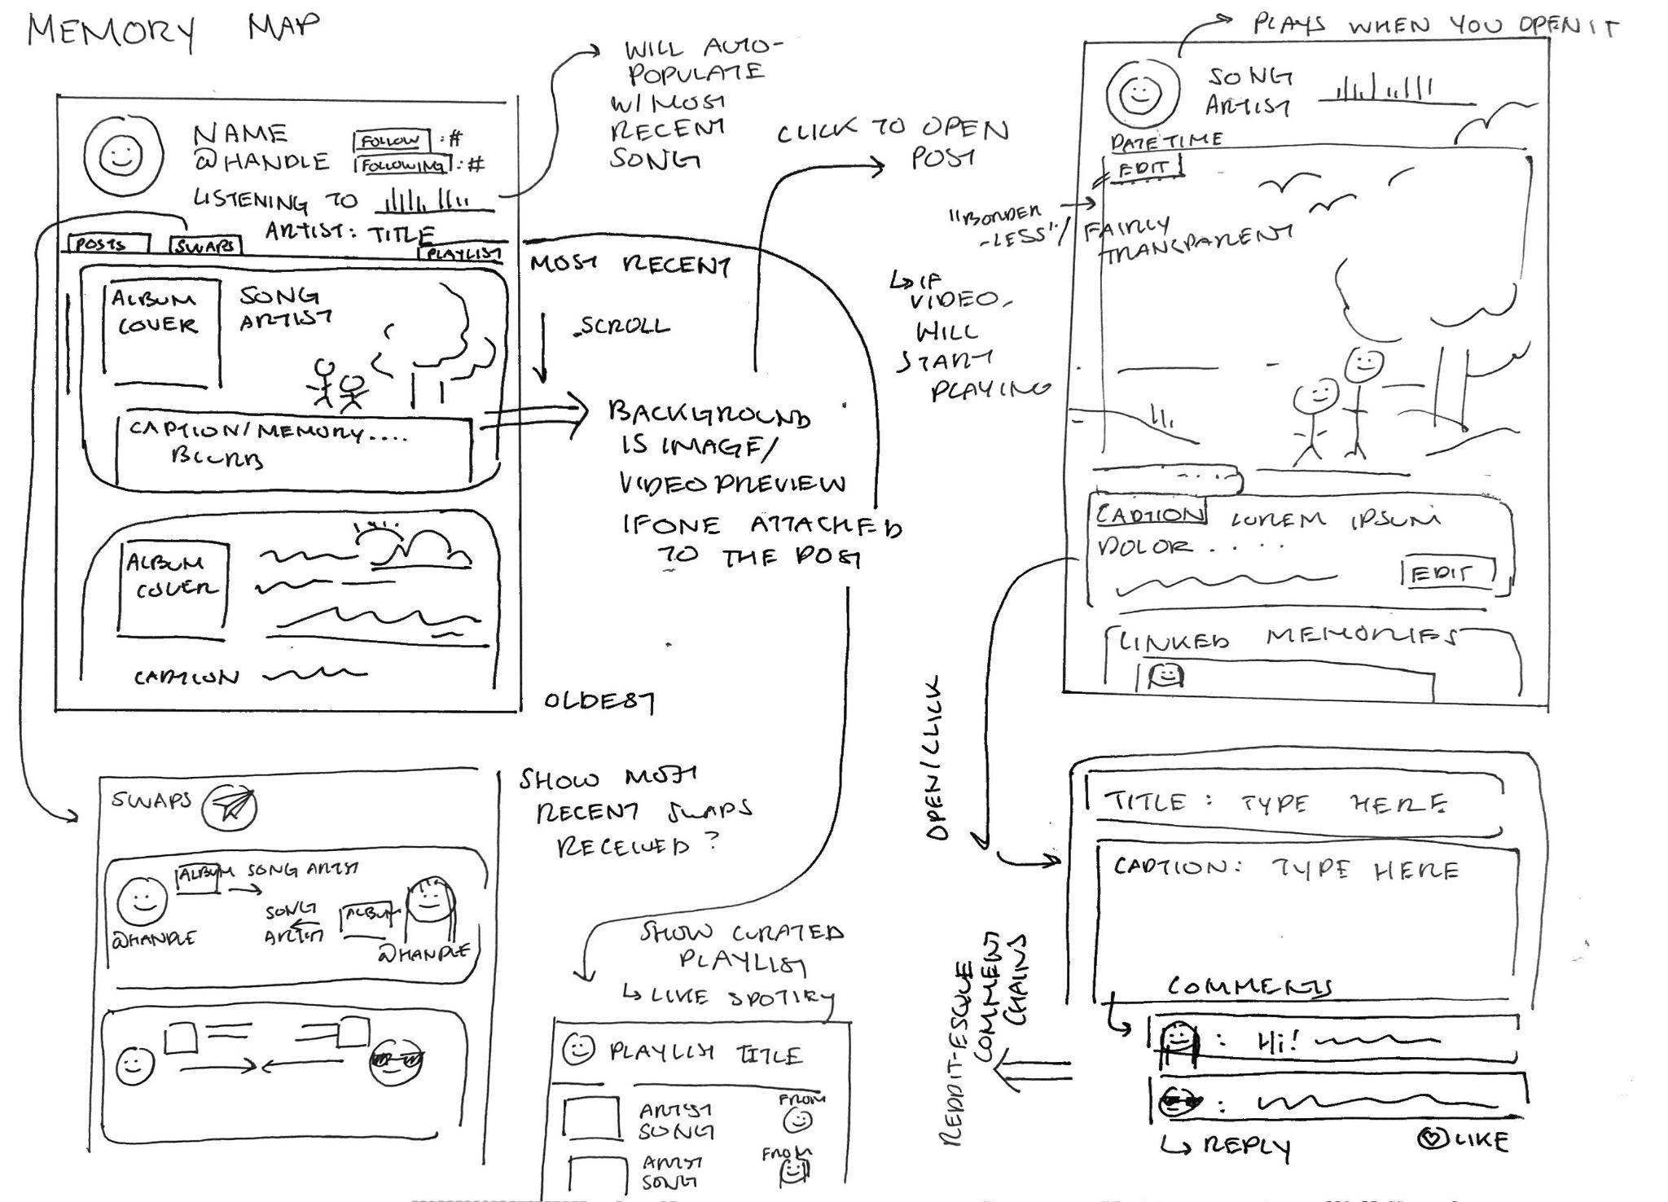
Memory Pages

Slide 14
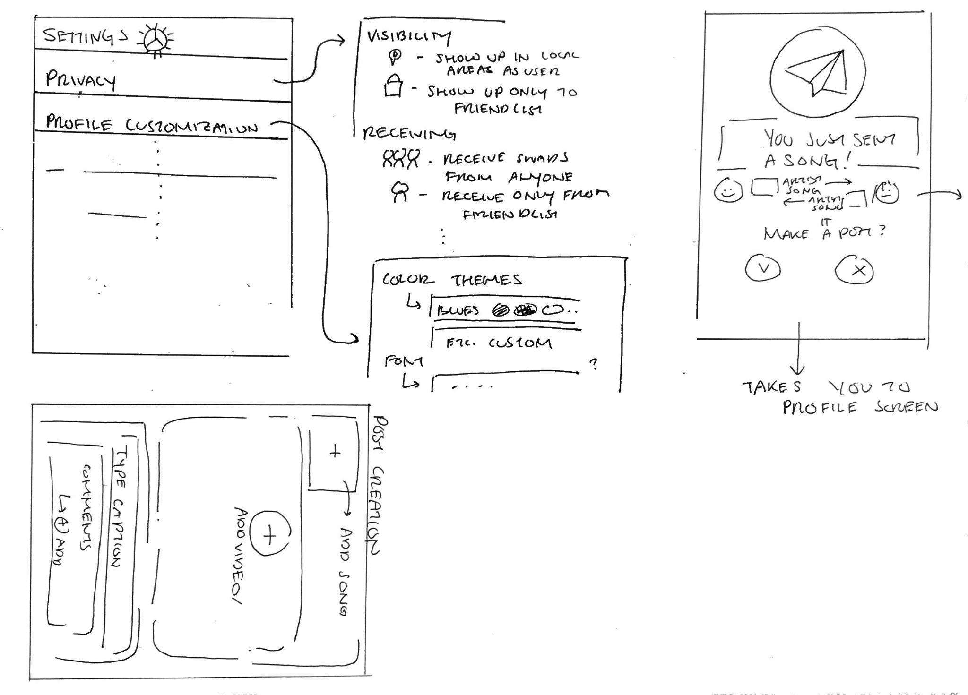
Memory Pages

Slide 15
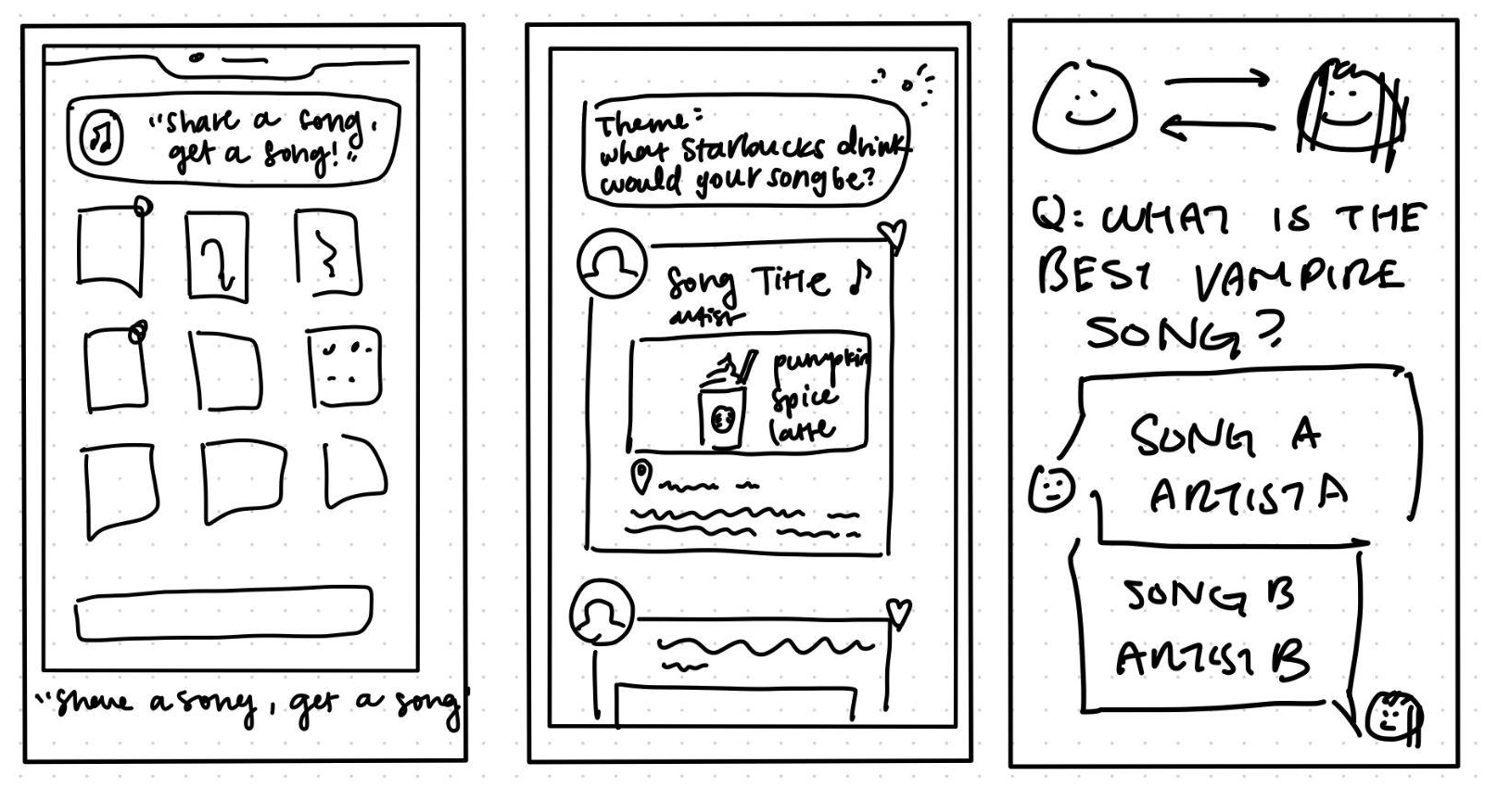
Realizations
Posting Prompts
Users get notified with random “question of the day.”
User selects from themed options that best represent their songs.
Users explore songs other users associated with various options.

Slide 16
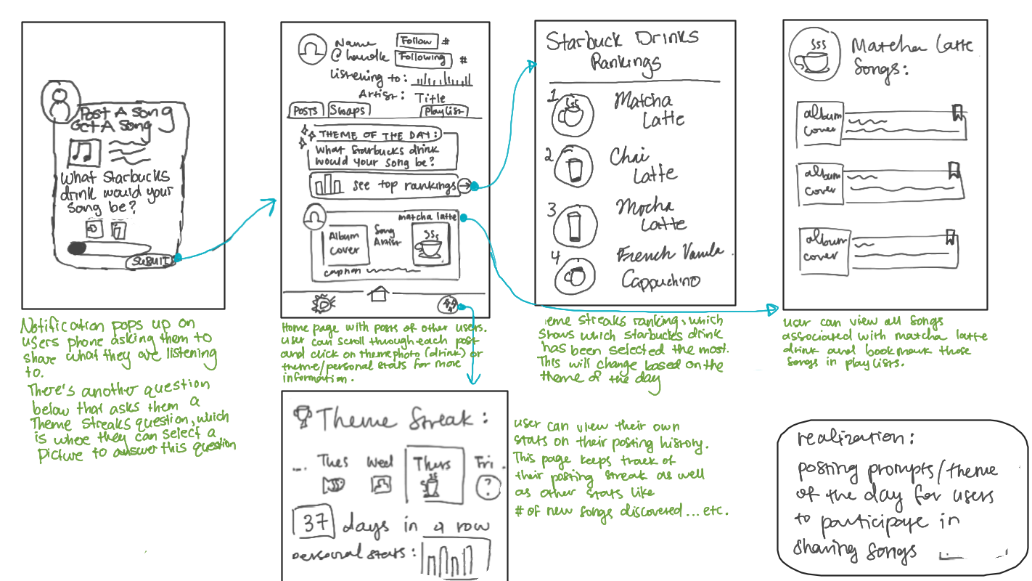
Posting Prompts

Slide 17
Interface + Rationale
04

Slide 18
Memory Pages
Pros
Cons
Central archive for important music and memories
Direct user interaction
Feels like a chore to post
Potentially not novel enough
Notes:
Central hub for a user’s important music and memories—stays true to archival goal
Direct user interaction (i.e. cong to each others memories, commenting on each others posts, linki
Feels like a chore to post
Potentially not novel enough—too similar to other apps

Slide 19
Posting Prompts
Pros
Cons
Communicating abstract music associations
Quick, fun, and simple
Themed questions may not be relatable or repetitive
Strays from archiving and sharing memories
Notes:
Communicating abstract music associations through symbolism
Quick, fun, and simple—things are open to interpretation
Themed questions may not be relatable
Loses the aspect of archiving and sharing memories with others
Themed questions may not be relatable
Loses the aspect of archiving and sharing memories with others

Slide 20
Considerations
Relevant Data
Findings
Music is intrinsically linked to emotion and memory—all three should be present
People want to share, but not always in words or in depth
Constraints
Our ability to represent associations is limited by technology
Notes:
https://www.ncbi.nlm.nih.gov/pmc/articles/PMC2776393/
Different modalities—find a different spin by asking themed questions

Slide 21
The Design
(+ Why It’s Superior)
We want the best of both worlds:
The everyday memory archival and emotional aspect from the “Memory Pages” Realization
The quick, fun, and symbolic representation of associations from the “Posting Prompts” Realization

Slide 22
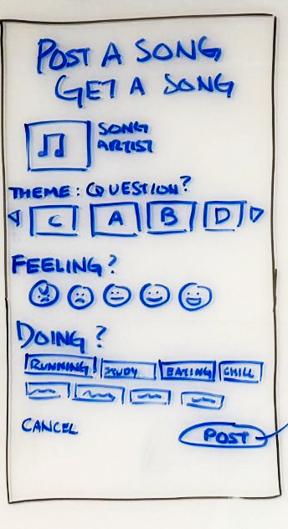
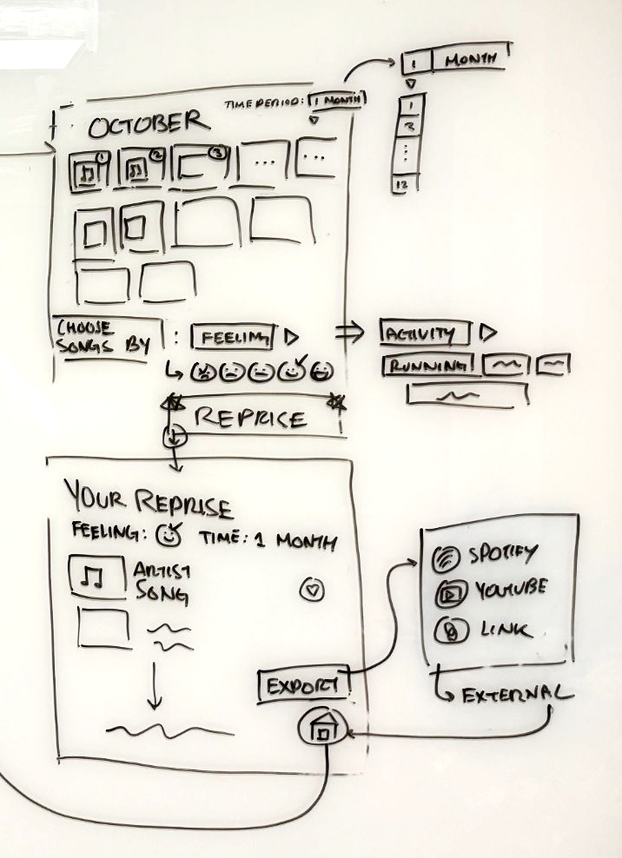
The Design (+ Why It’s Superior)
We want the best of both worlds:
Everyday memory archival and emotional aspect
Quick, fun, and symbolic
Instead of asking only the theme question in relation to their song, ask users to log what they’re feeling and doing from a selection, then let them look back on all the songs they associated with a certain feeling or activity.
Notes:
Instead of asking only the theme question in relation to their song, ask users to log what they’re feeling and doing from a selection, then let them look back on all the songs they associated with a certain feeling or activity.

Slide 23
The Design
(+ Why It’s Superior)
We want the best of both worlds:
Everyday memory archival and emotional aspect
  Log current feeling and activity
  Calendar History
Quick, fun, and symbolic
  Themed Question
  Answer Selection
Notes:
Instead of asking only the theme question in relation to their song, ask users to log what they’re feeling and doing from a selection, then let them look back on all the songs they associated with a certain feeling or activity.

Slide 24
Low-fi Prototype
05

Slide 25
Low-fi prototype construction
Sketching
Cutouts
Rough sketches on whiteboard
Printed and cut designs
01
03
Brainstorming
02
Revisions
04
Proposed ideas and voted
Cleaned sketches on Goodnotes

Slide 26
Tasks + Features

Slide 27
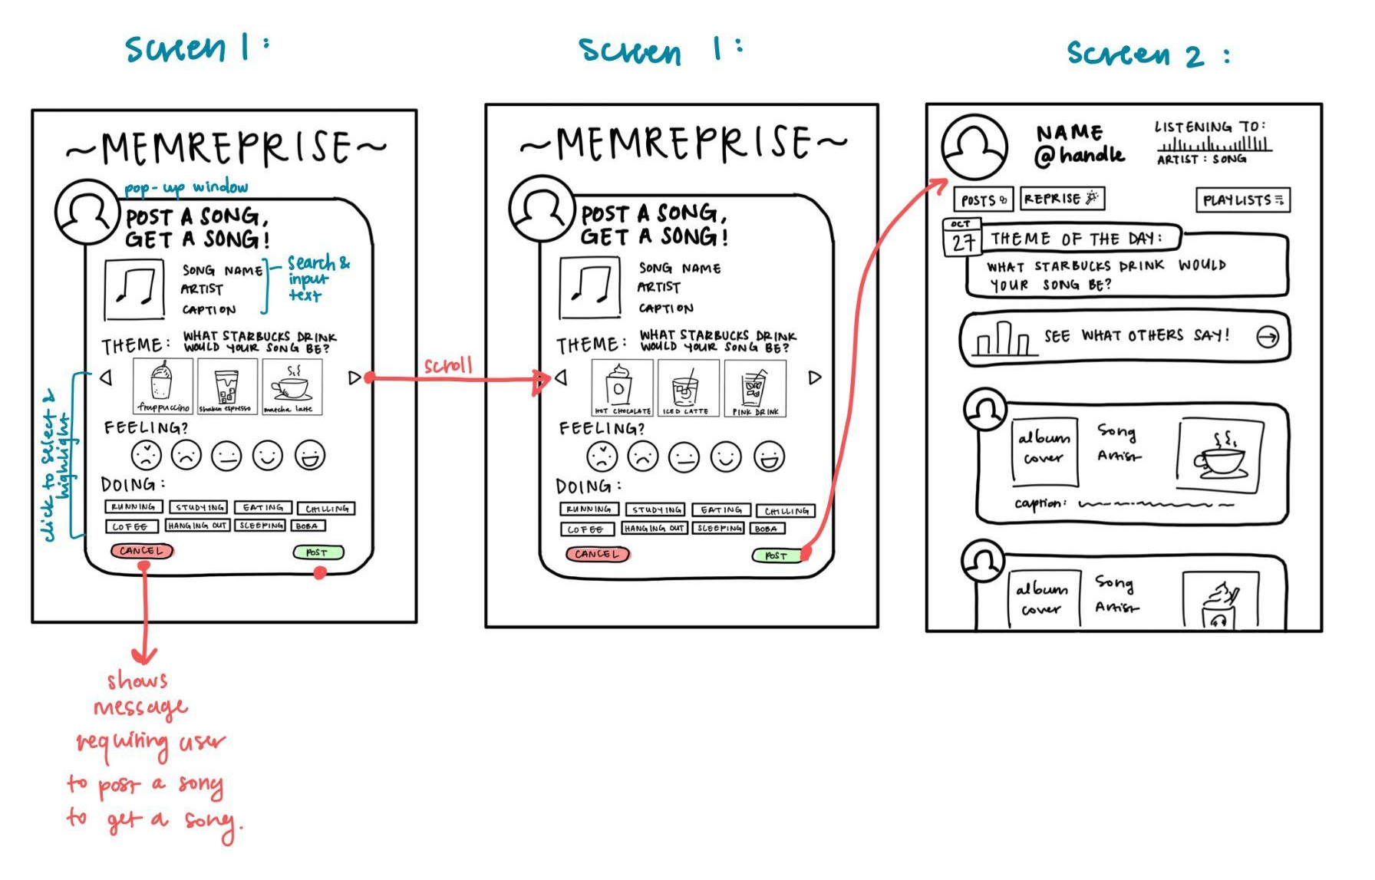
Simple: Share a song on MemReprise
Features:
Scroll arrows for the theme question options.
Select & highlight feature to show user’s choice.
Post button leads to home page feed.
Cancel button closes the post draft.
Notes:
Add features that are accessible in the relevant task

Slide 28
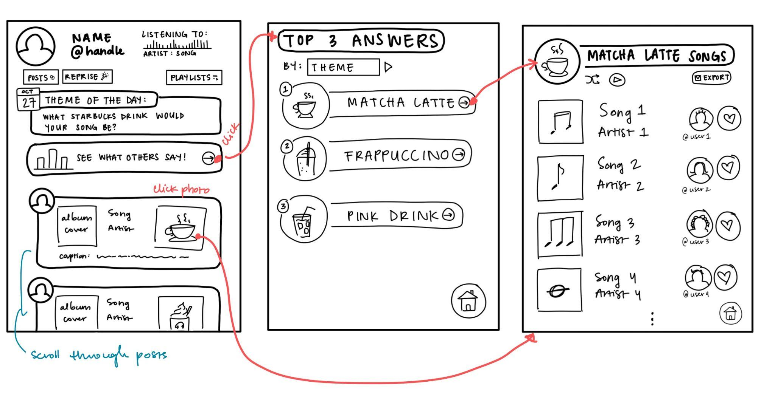
Moderate: Discover music from other users
who have similar music associations.
Features:
Arrow button opens Top 3 Answers per category.
Button on theme photo links to themed playlists.
Category Swipes helps users view Top 3 Lists for different categories.
Scroll through songs posted by other users.

Slide 29
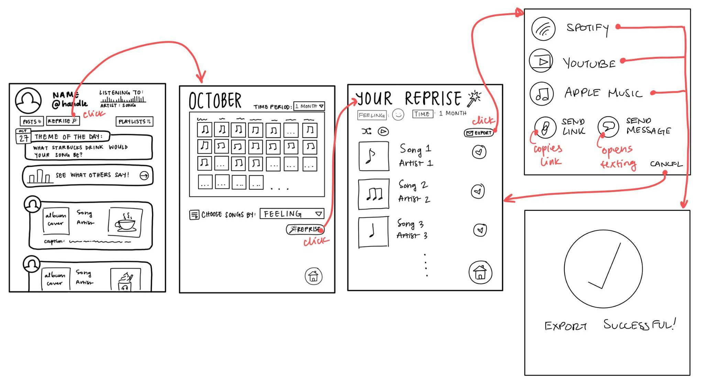
Complex: Create a personalized playlist
from songs you recently shared.
Features:
Reprise button in home page opens post history.
Dropdown allows user to filter post history.
Reprise button on history page generates playlist.
Export button opens links to save playlists on other streaming apps.
Home button to return to the home page.
Cancel button stops export.

Slide 30
Testing Methodology
06

Slide 31

Participants
Natalia
Clare
01
03
High School Student
Infrequent social media user
Stanford Student
Orchestra experience
Benedict
02
Adrian
04
Network Engineer
Experienced research participant
Software Engineer
Degree in Information Systems
Notes:
Notes: Natalia is not a frequent social media user
Adrian was in band

Slide 32
Participants
Natalia
Clare
01
03
High School Student
Recruitment: Student of Friend
Compensated: No
Stanford Student
Recruitment: Friend
Compensated: Boba
Benedict
02
Adrian
04
Network Engineer
Recruitment: Friend’s brother
Compensated: No
Software Engineer
Recruitment: Friend
Compensated: Boba
Notes:
Notes: Natalia is not a frequent social media user

Slide 33
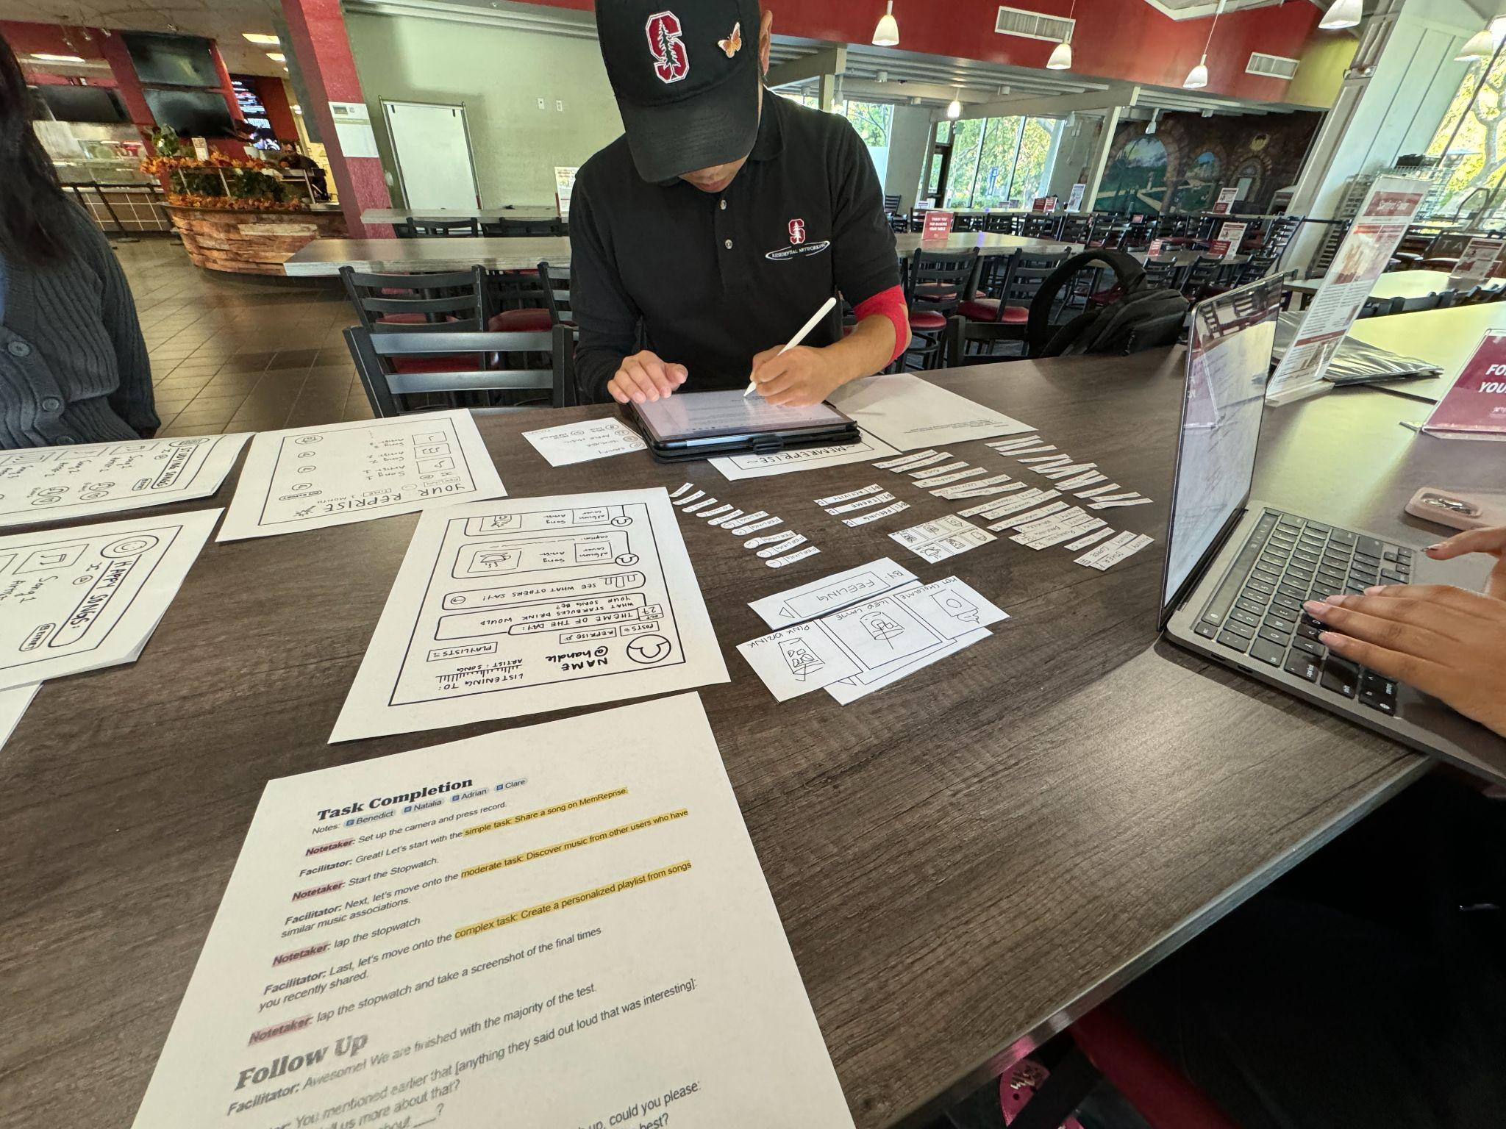
Environment + Apparatus
Apparatus
Locations
  Tressider
  Coupa Cafe (GSB)
  EVGR-A Huddle
Apparatus notes: Low-fi paper prototype to simulate real app usage. Recorded with consent for analysis.

Slide 34
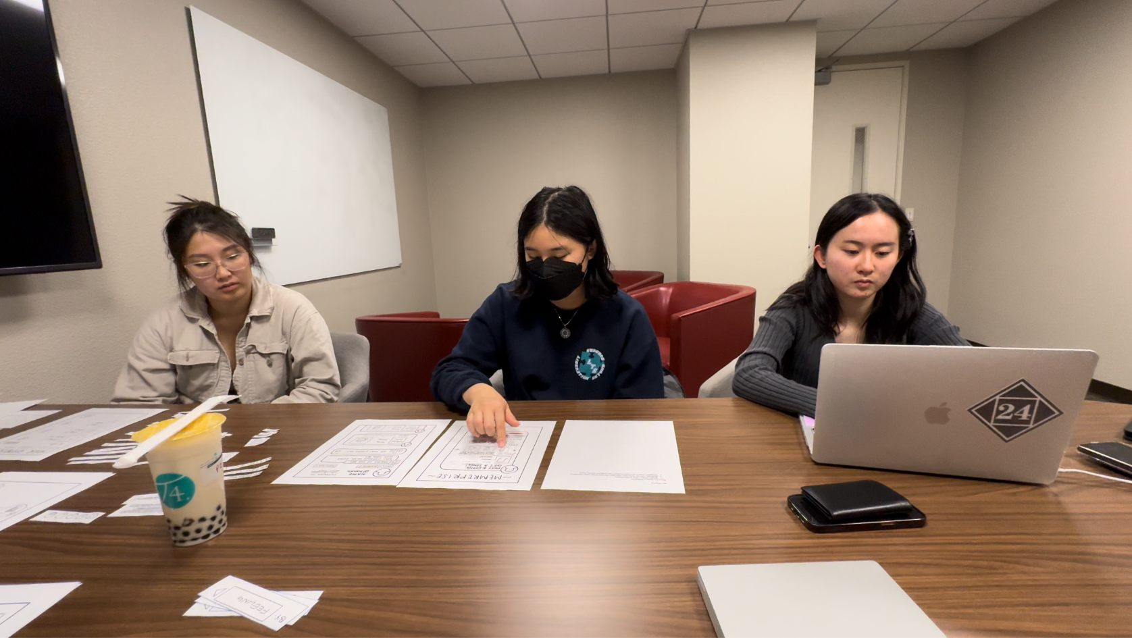
Process + Team Roles
Computer
User
Notetaker
~30 minute sessions
  3 tasks of varying complexity
Team roles:
  Greeter + Facilitator
  Notetaker
  Computer
Encouraged participants to think aloud
  Real-time feedback
Facilitator facing user

Slide 35
Process + Team Roles
Sessions lasted ~30 min
  3 tasks of varying complexity
Team roles:
  Greeter/Facilitator, Notetaker, and Computer
Encouraged participants to think aloud
  Real-time feedback on their experience

Slide 36
Usability Goals + Measurements
App Efficiency
User Satisfaction
KPI: monitored time to complete each assigned task
KPI: collected user satisfaction ratings + verbal feedback
Robustness
KPI: tracked error rates with points of failure or confusion
KPI = Key Performance Indicator

Slide 37
Testing Results
07

Slide 38
Results
Big Picture
Bottom-Line
Participants completed all tasks, though time and ease varied
Diverse navigation paths:
  showcasing adaptability.
Minimal errors recorded.
Positive rating for average user satisfaction (~4/5)
Other relevant observations
Areas of potential confusion were noted, such as the need for clearer navigation cues.
Notes:
Note: (5-13 min) some participants took longer because they were thinking aloud more, not necessarily because
it was difficult for them
Relevant Observations: Buttons vs. tabs confusion

Slide 39
Discussion
08

Slide 40
Implications
The word “Reprise”
Discover Songs
01
Not common vocabulary which made the button ambiguous.
03
Discovering songs was easy for our participants. Everyone found what others’ post.
Posting A Song
Profile
02
Users were confused how to post their songs; text-heavy
04
Users wanted to click their personal profiles and profiles of other users.
Notes:
Posting vs. Sharing
Focused on just sharing the song, were confused about the prompts—clarification/info helpful
Profile:
What does home feed represent
Discover:
People were curious, interesting and novel to associate things

Slide 41
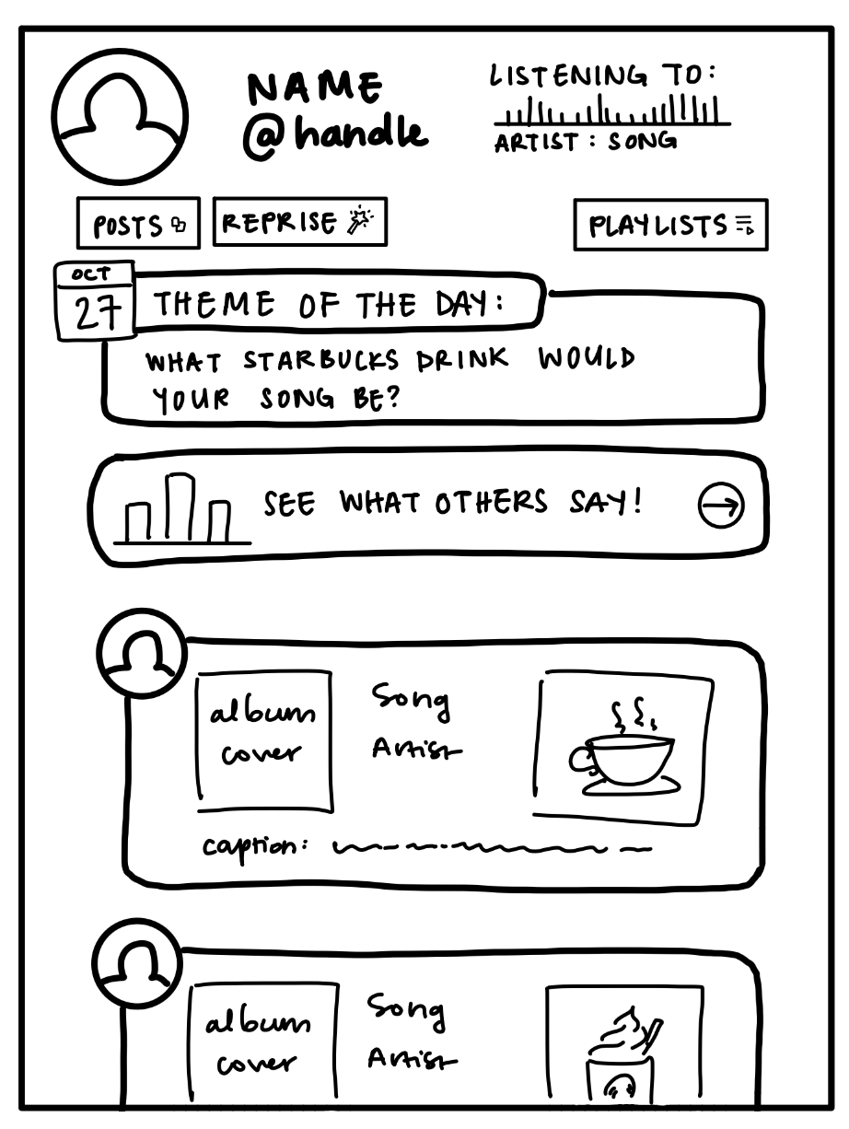
Changes to Design
Tutorial
01
Create a tutorial for new users to learn how to use the app
2) Remove Playlist
02
Saving personal playlists in user’s profile. Playlists on the homepage was confusing.
Notes:
Observations

Slide 42
Testing Couldn’t Reveal
Usage
Are users willing to use our platform every day to share their songs?
Discovering / Liking New Songs
There were no real songs shown in our prototype so we don’t know if users would discover new songs they like
Ignore Notifications
Couldn’t test if users would ignore the notification and not share their song

Slide 43
Thank
You!

Slide 44
Appendix
Full list of pros and cons for selected interface rationale
  Slide 8 and 10
Link to the low-fi prototype on Marvel POP, etc.
  Low-fi prototype
Any preparation you did for the testing (e.g., script)
  Prototype Script
Organized log of critical incidents from testing
  Critical Incidents Log
See the details features and interaction details in the next slides.

Slide 45
Features & Interactions

Slide 46
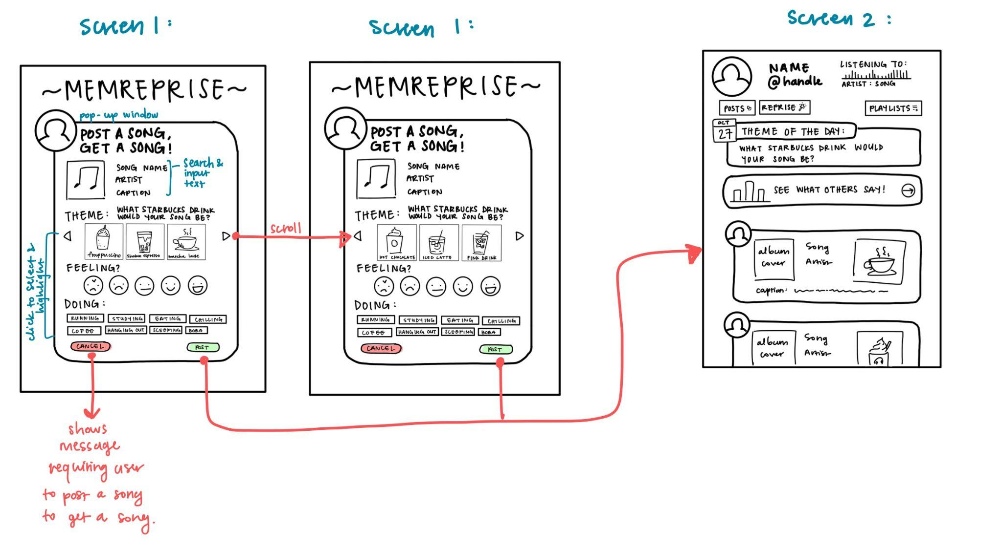
Screen 1: Post Draft

Slide 47
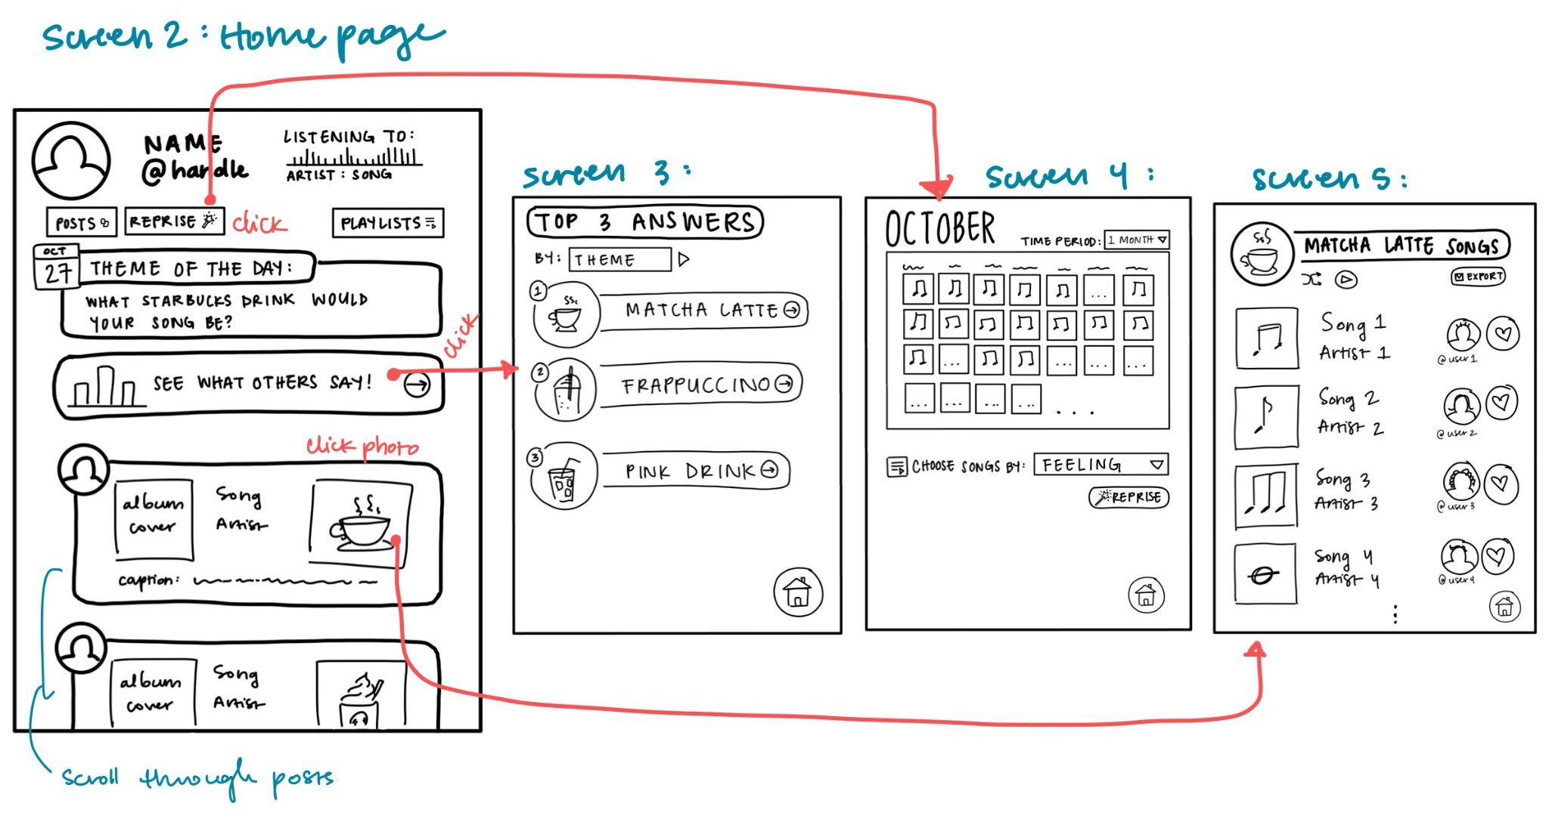
Screen 2: Home Page

Slide 48
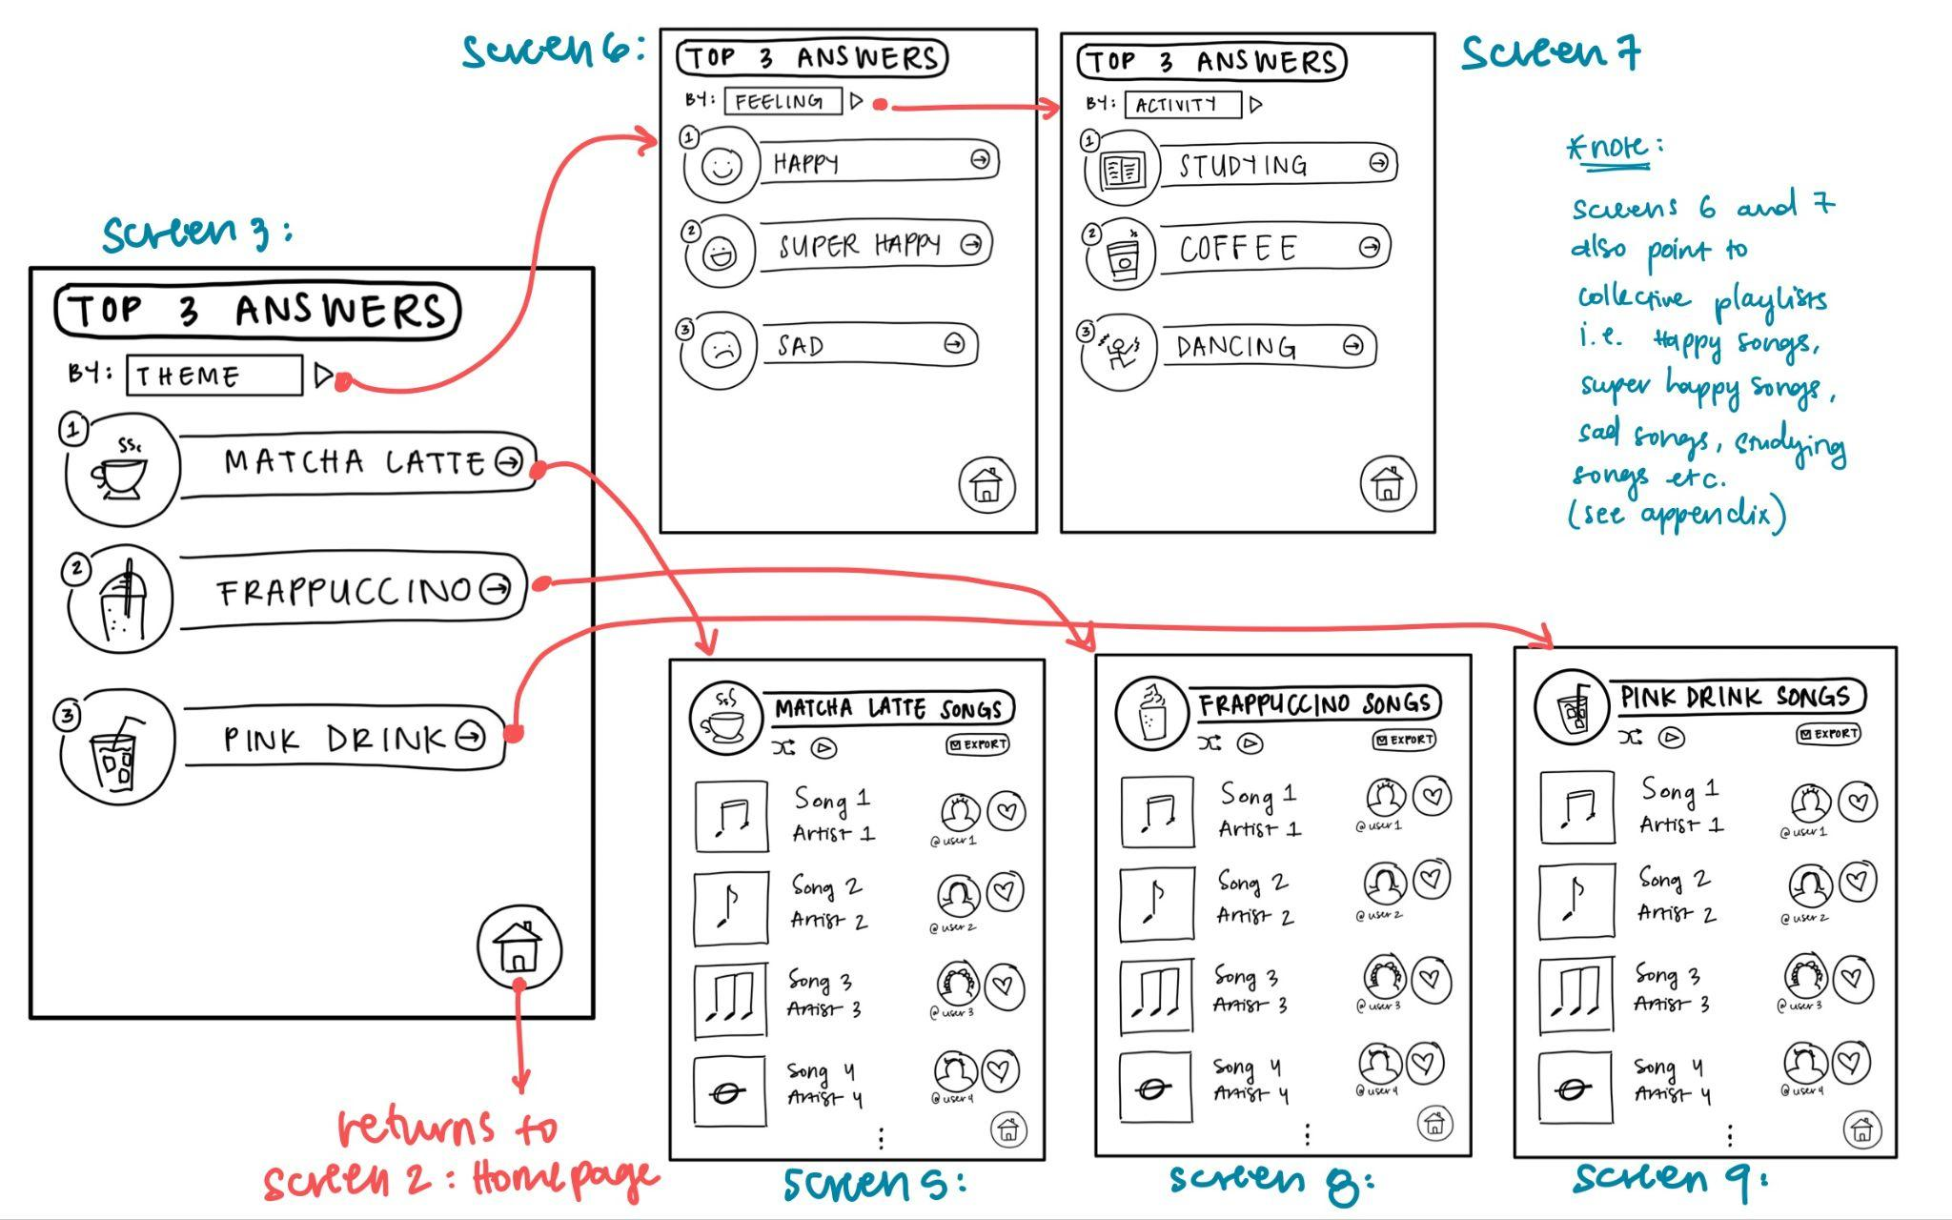
Screen 3: Top 3 Playlists per Category

Slide 49
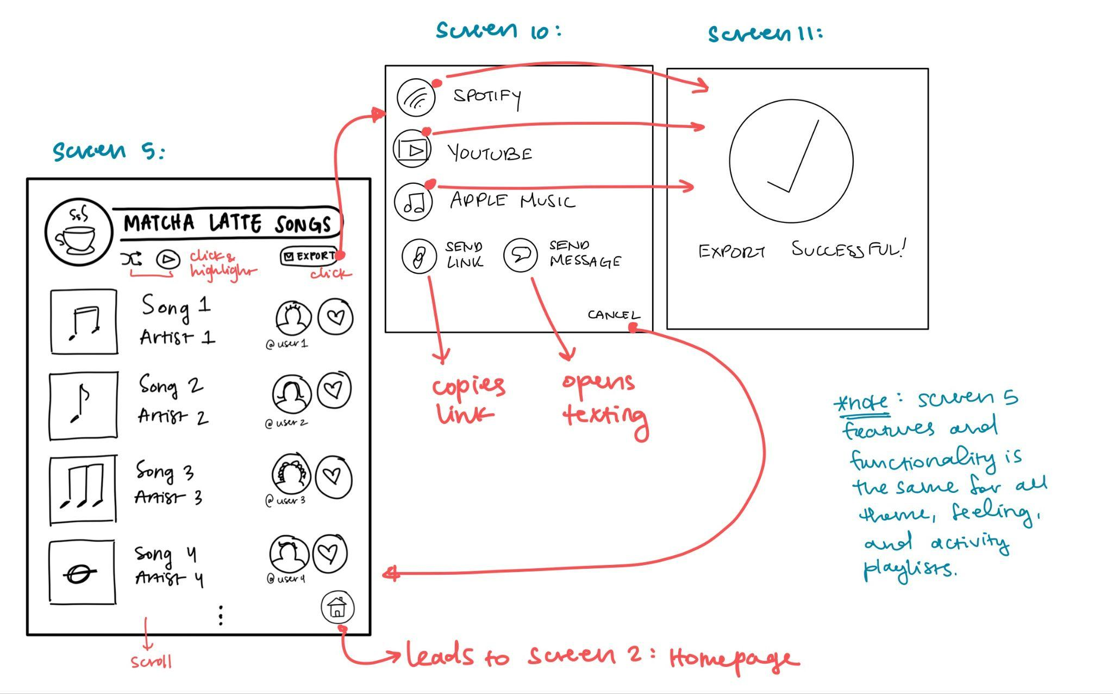
Screen 5: Top 3 Playlist

Slide 50
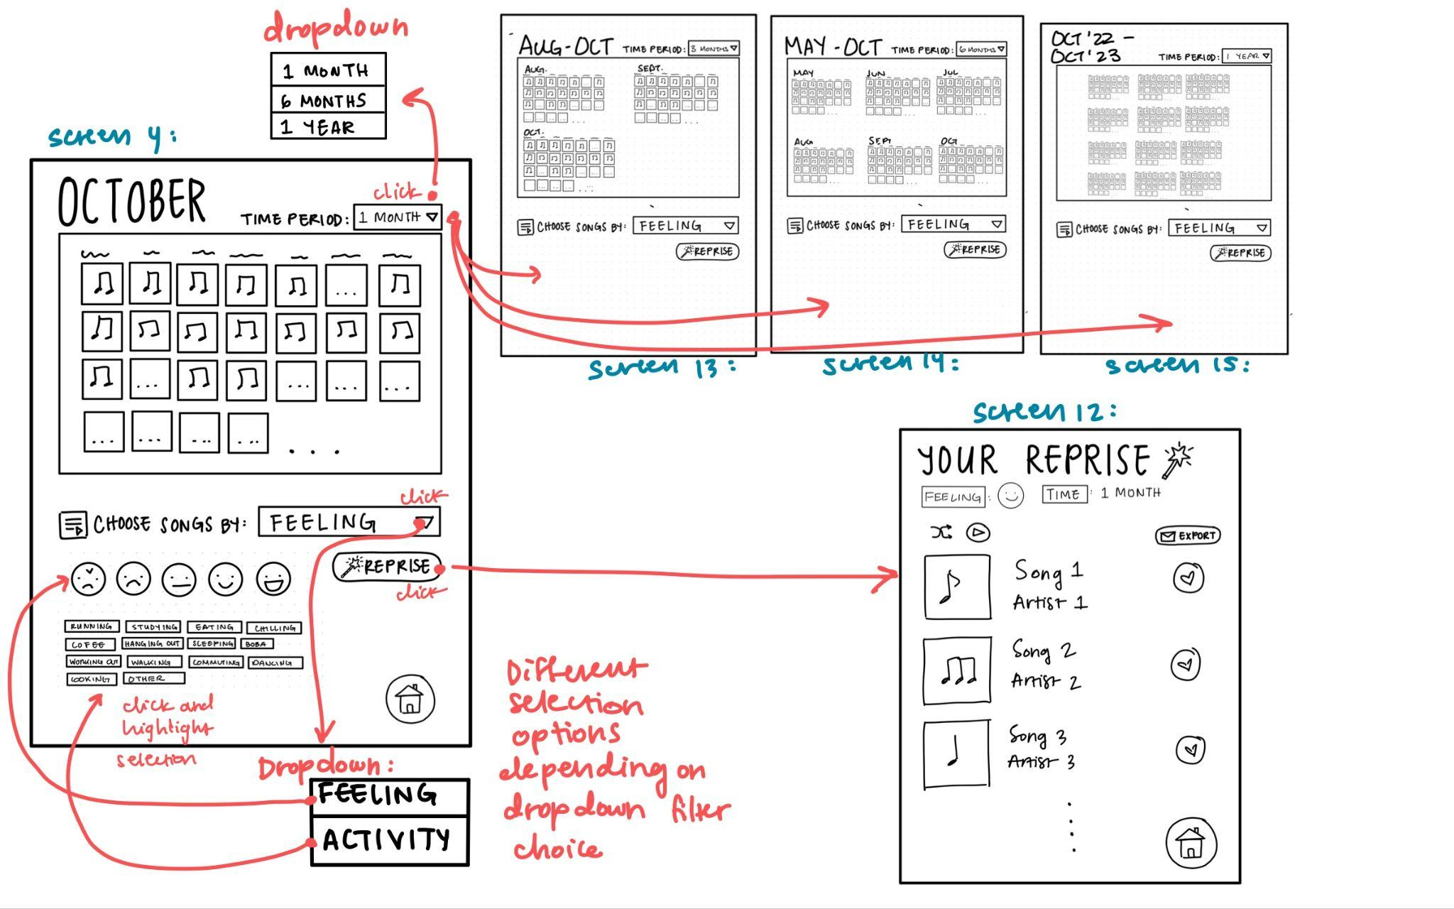
Screen 4: Recent Posts + Calendar

Slide 51
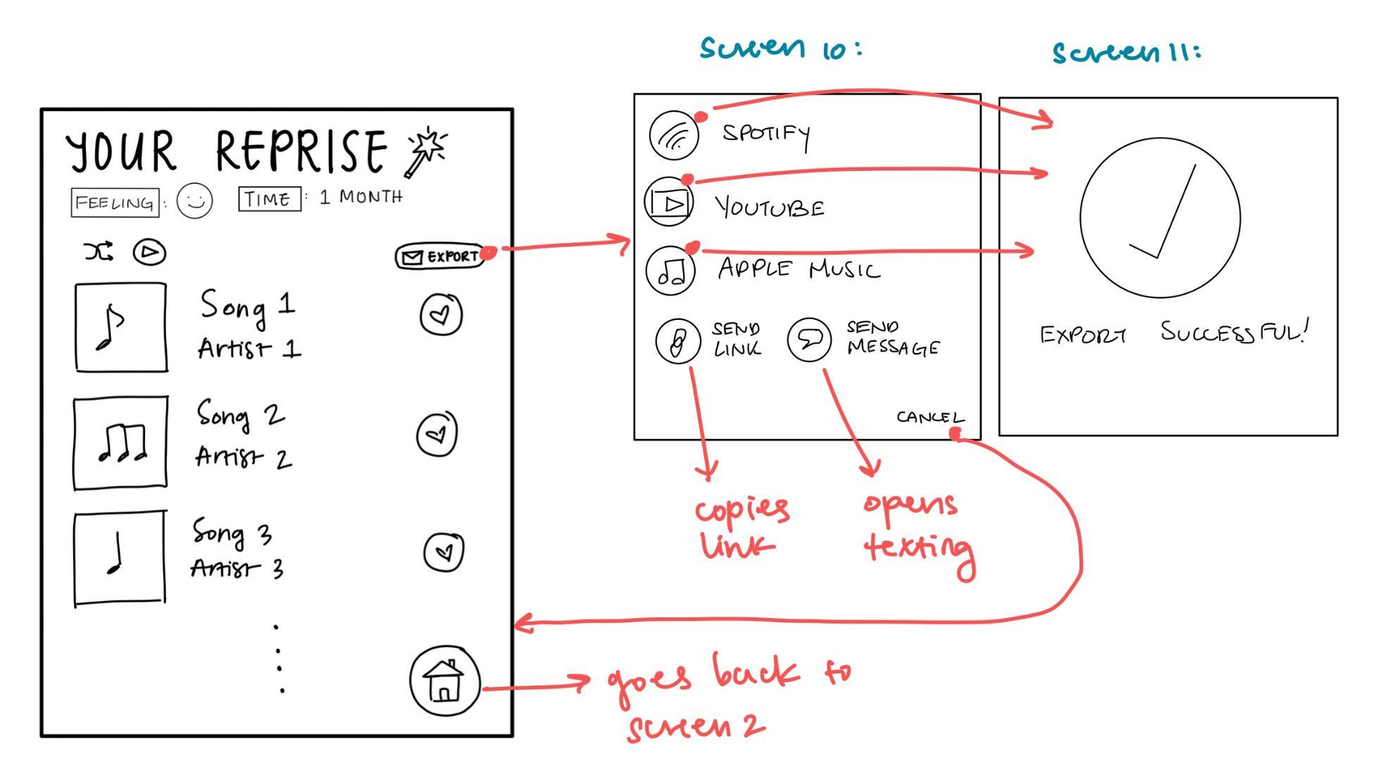
Screen 6: Your Reprise

Slide 52
Crazy 8’s Sketches

Slide 53
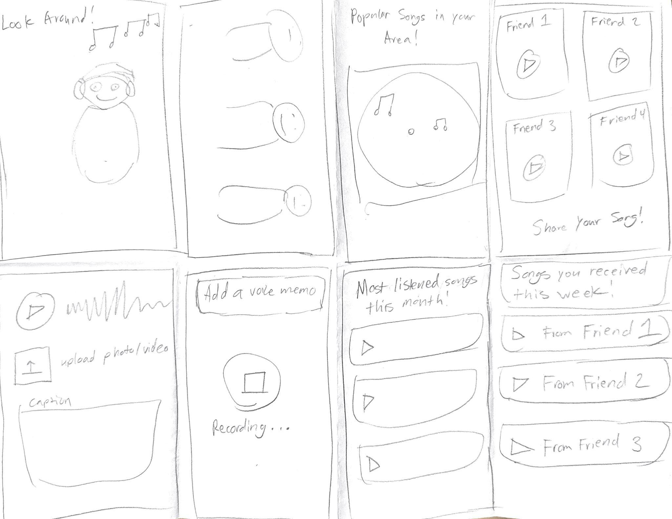
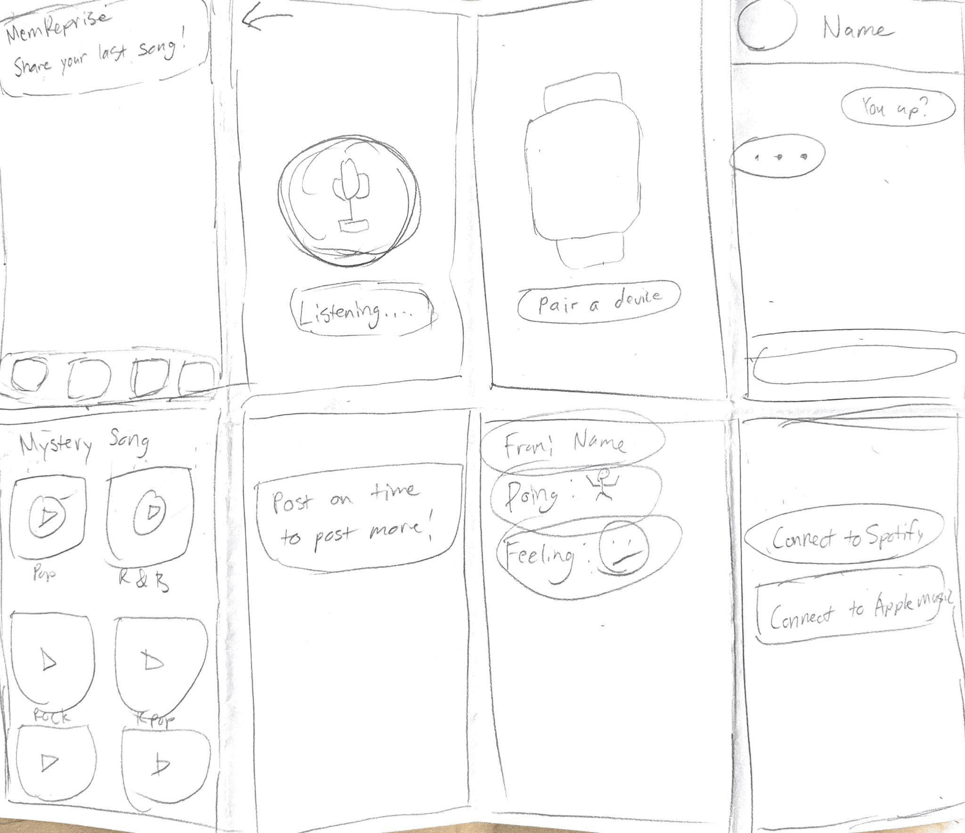

Slide 54
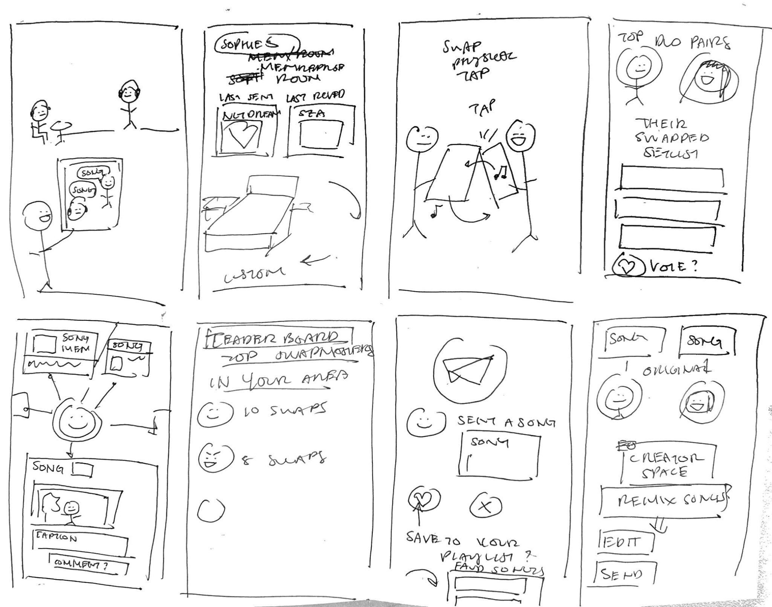
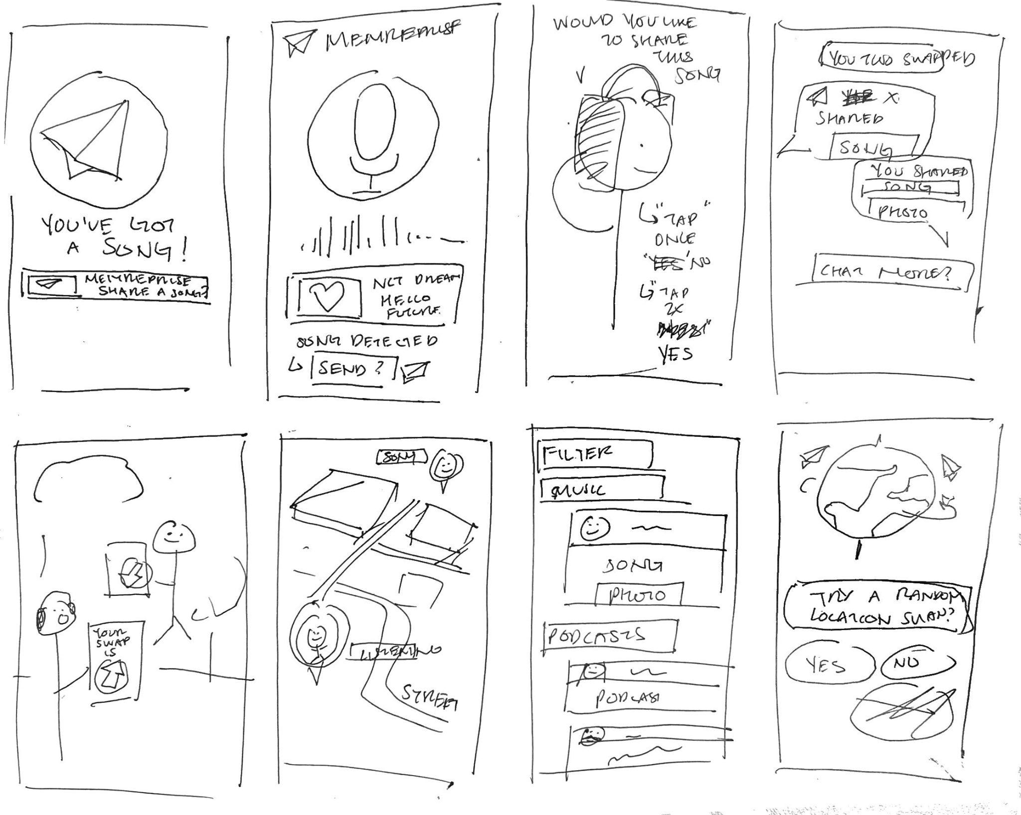

Slide 55
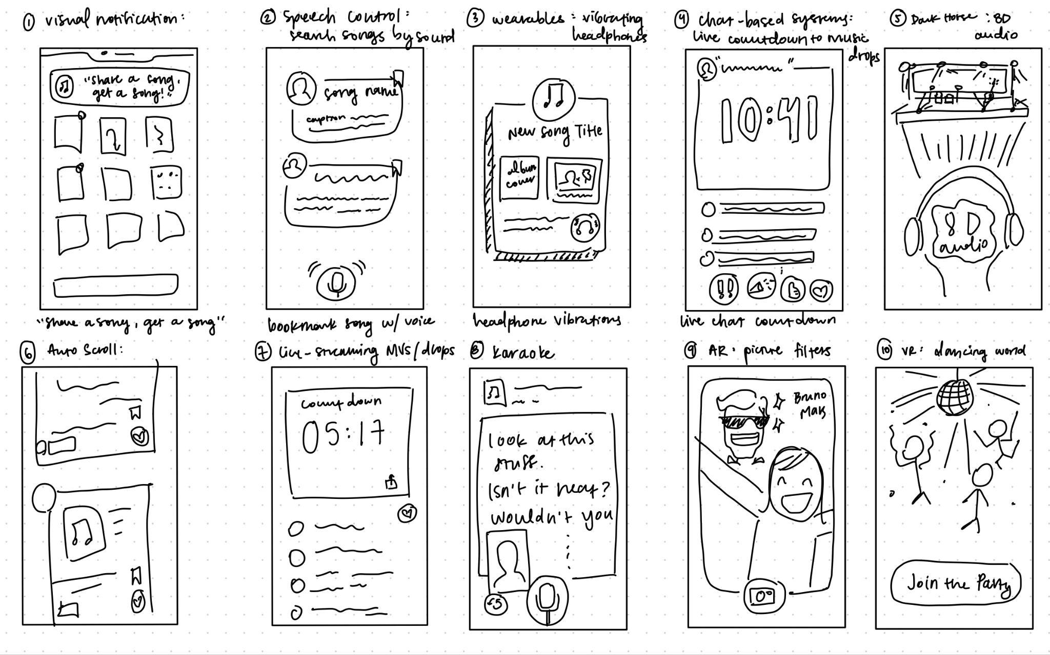
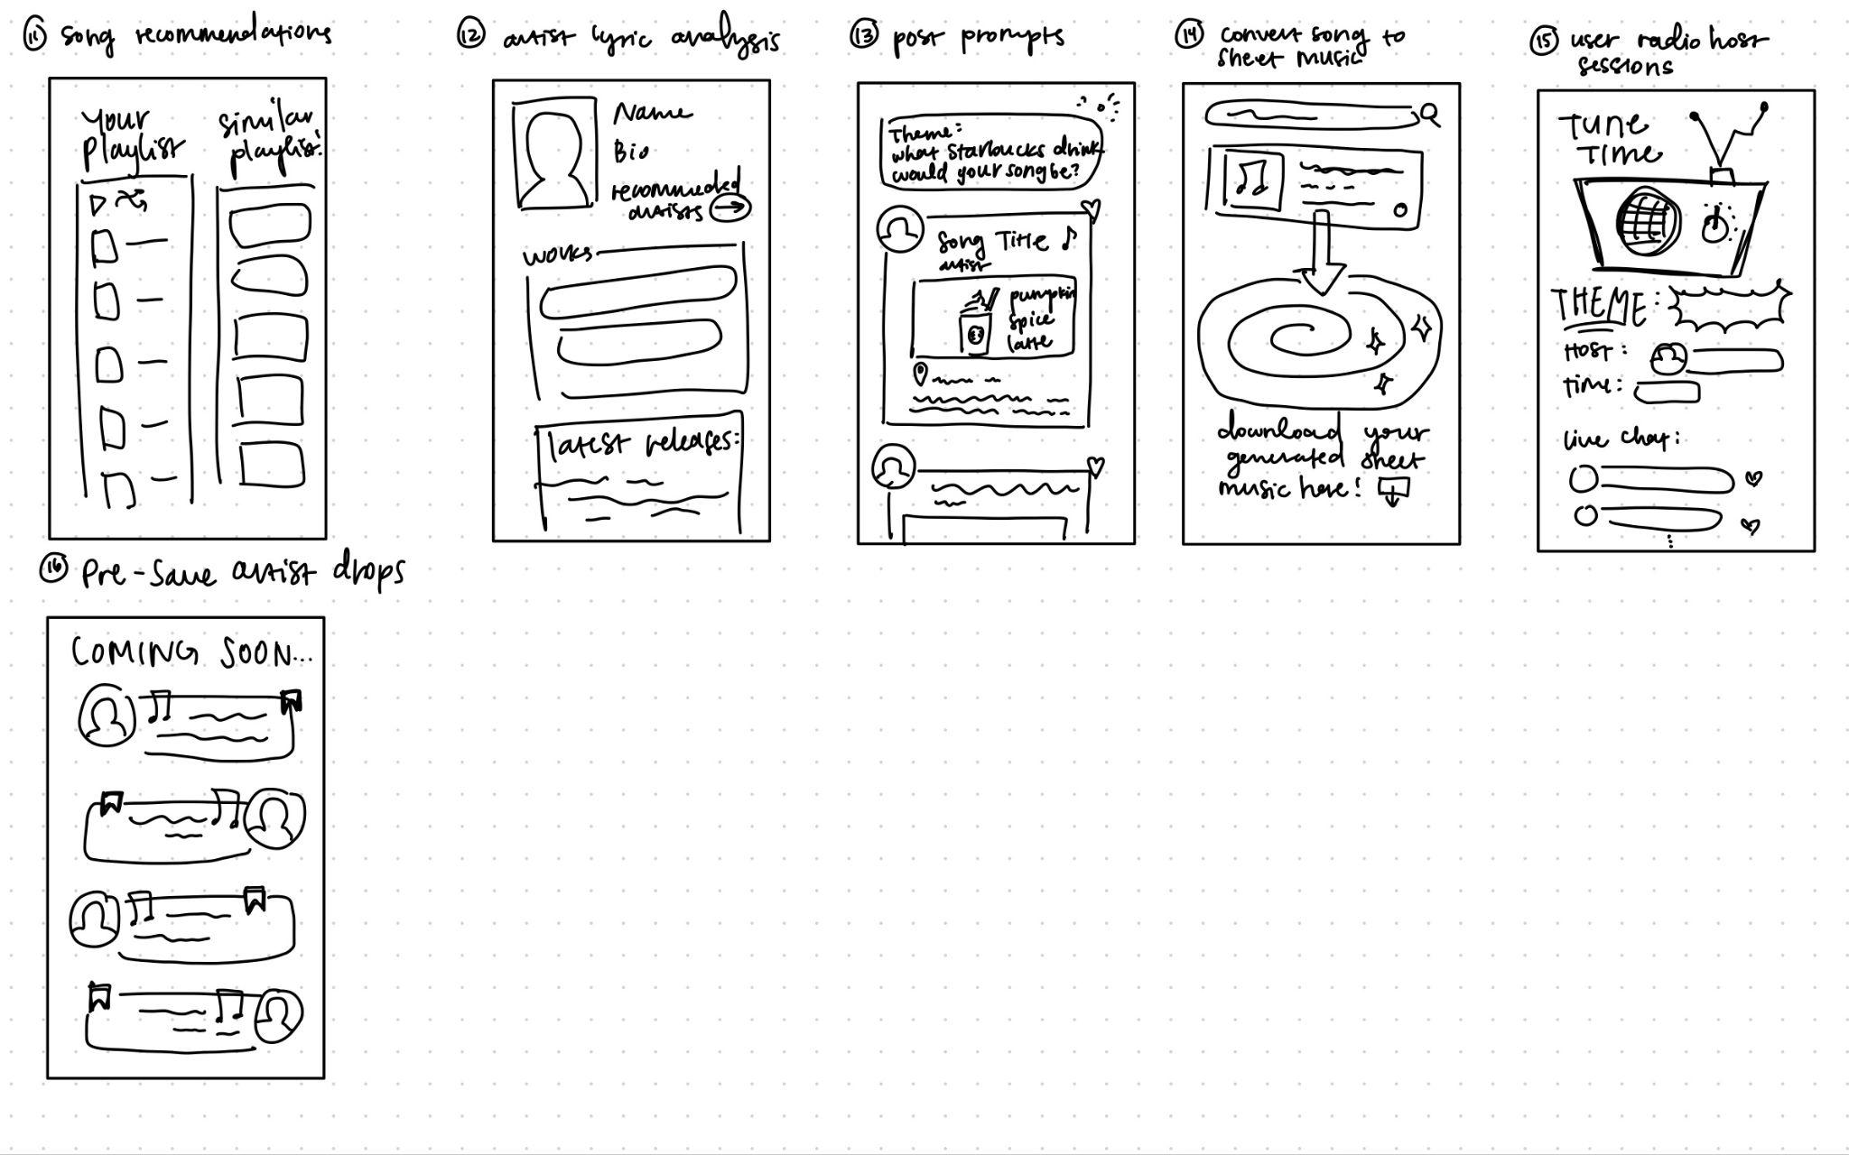

Slide 56
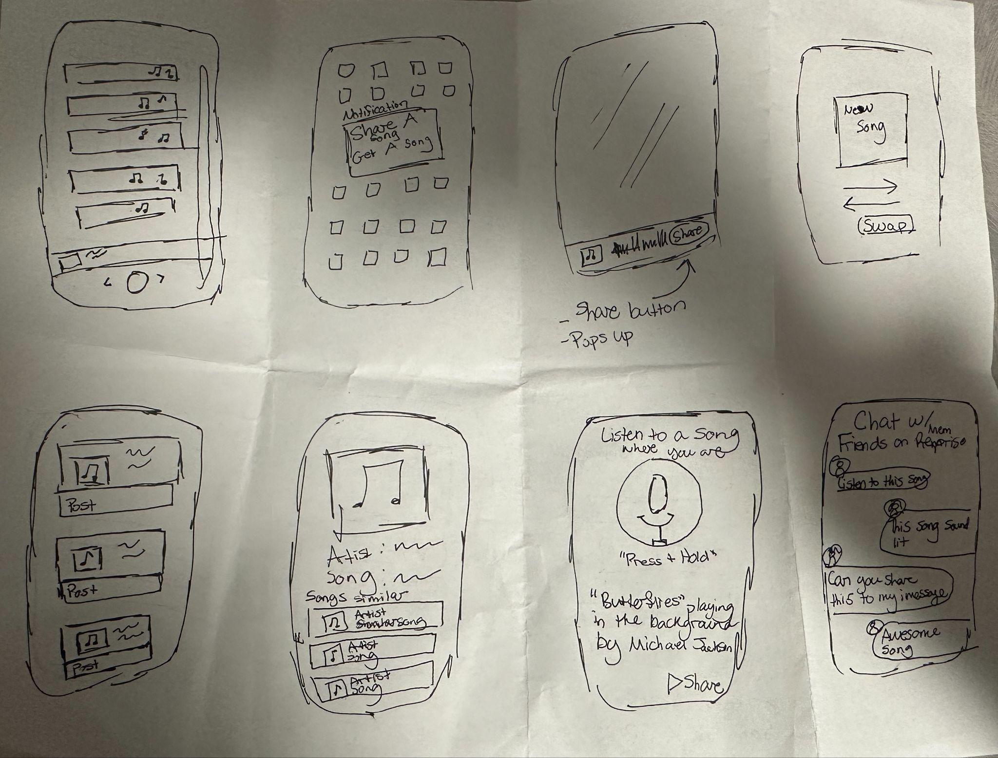
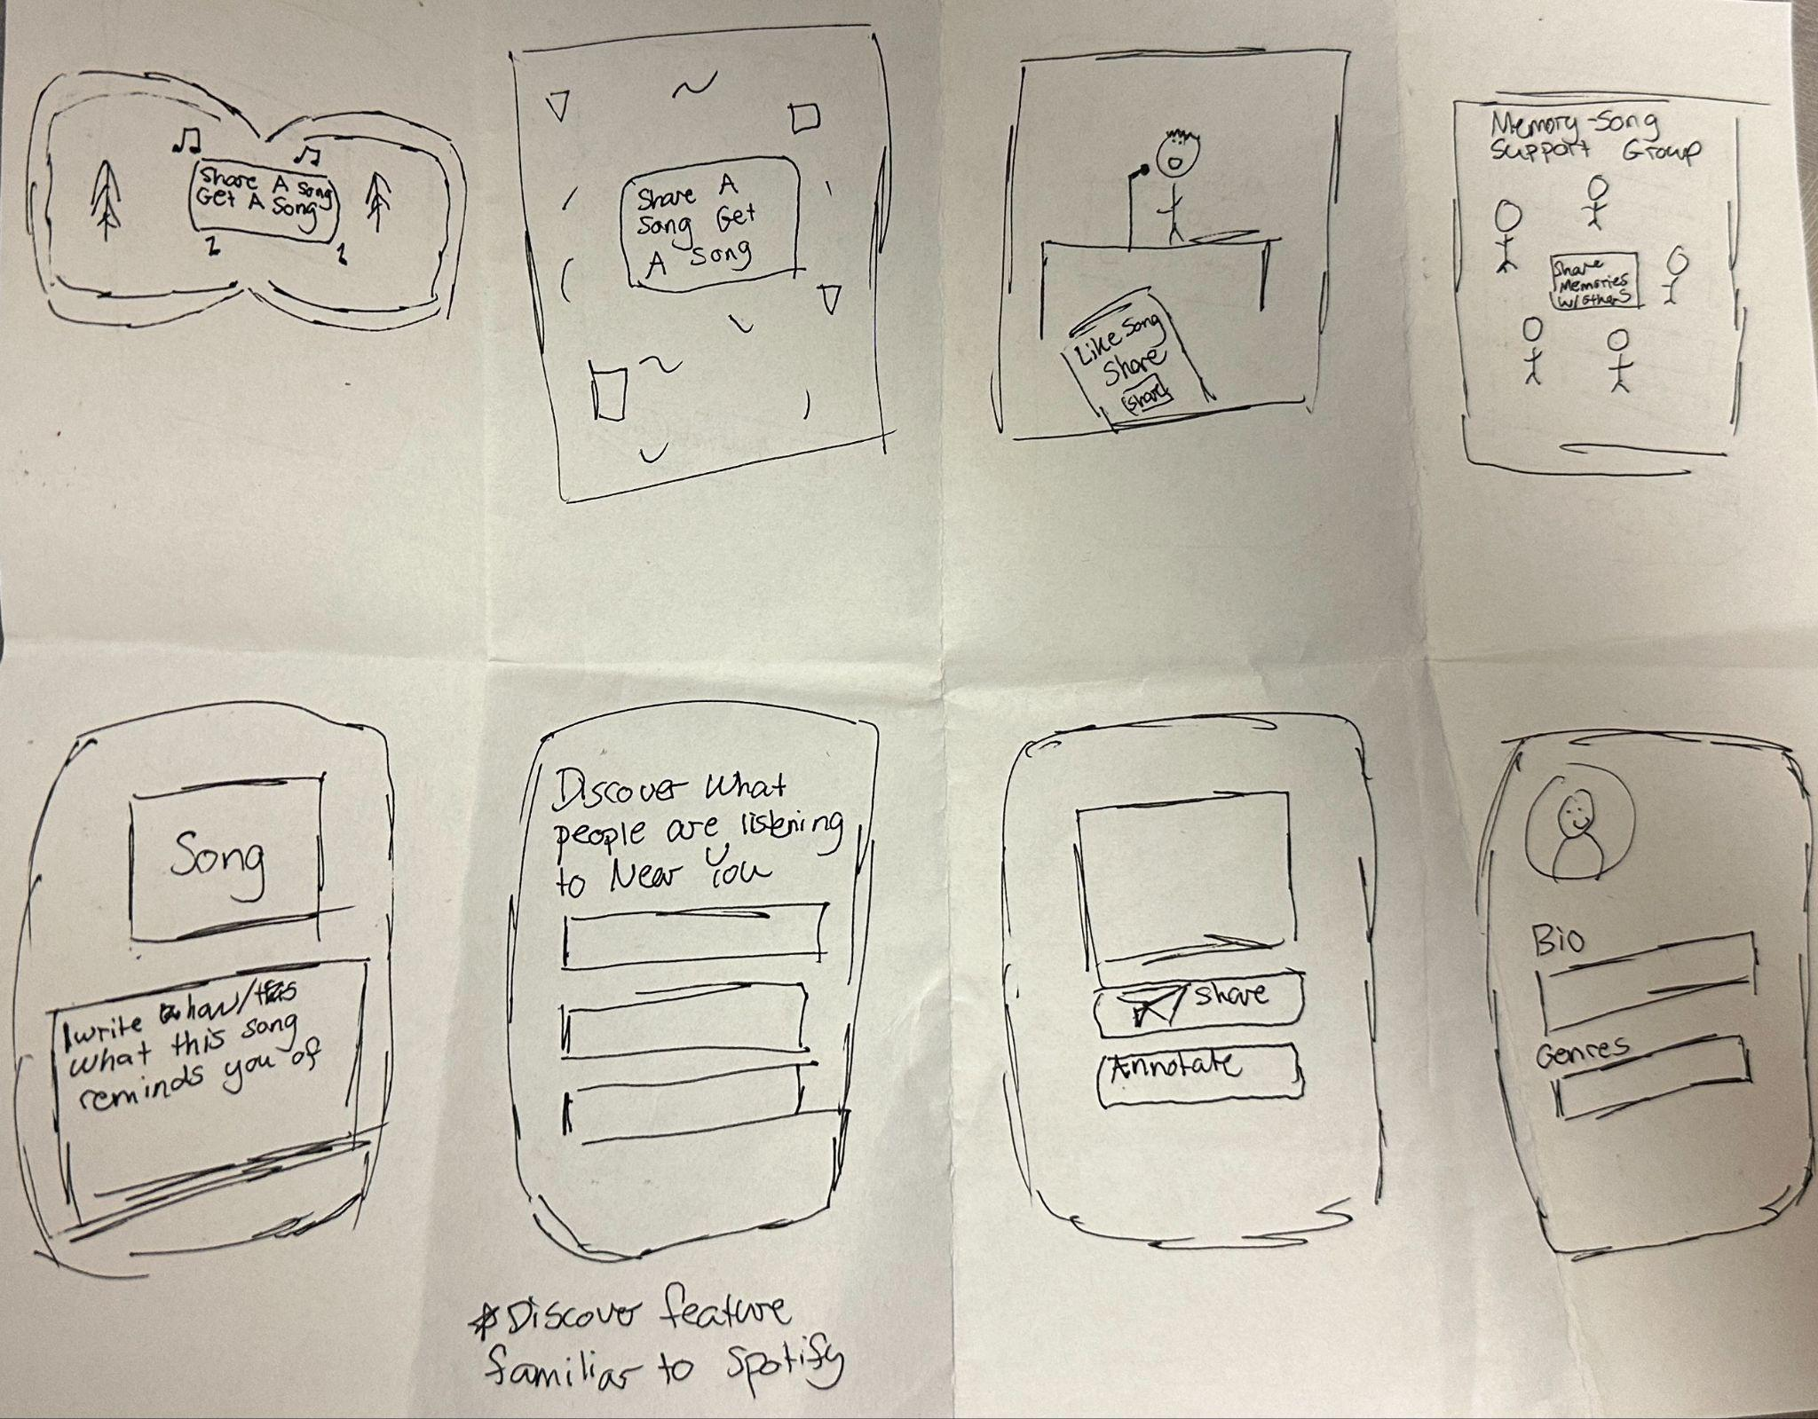

Slide 57
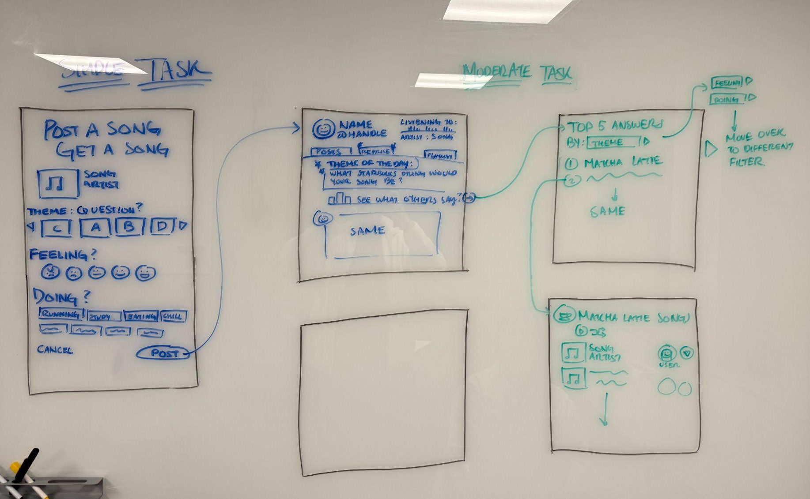
Initial Storyboard

Slide 58
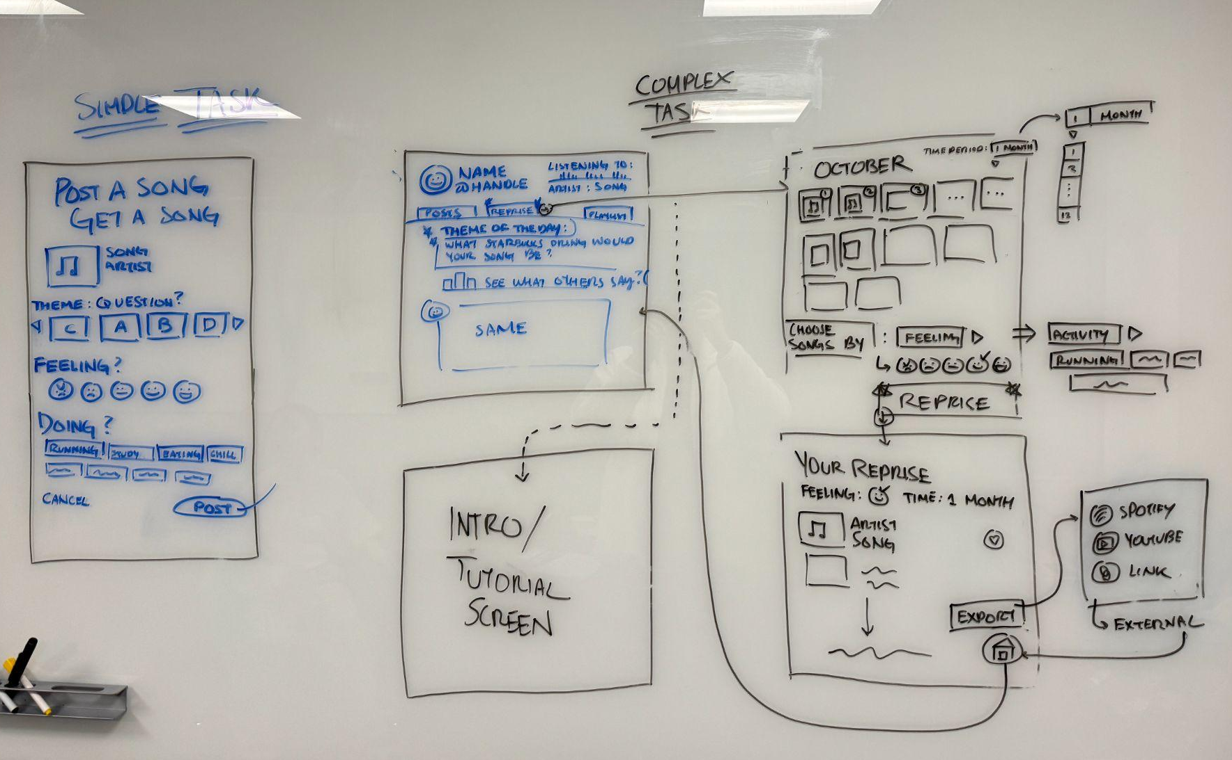
Initial Storyboard

